Slide 1

Hospital management system

Slide 2
Team-3
Prasad Dasari 2478754
Raviteja G 2478829
Shweta Satpute 2478369
Vandana Devarinti 2478525
Surya C 2478359
Dhinesh Shanmugasundaram 2478469
Pothuri Sumanth 2479145
Suman Sanjeeb 2478364
Virupakshappa J Satannavara 2478341
Kasetty Lakshmi Prasanna 2479033

Slide 3
Contents
Introduction
Why hospital management system ???
Objectives
Tools & languages used
System Requirements
App Flow
Features Available
Future Scope & Improvement
Conclusion

Slide 4
Hopsital management system
The project Hospital Management system includes registration of patients, storing their details into the system, and also computerized invoice.
The software has the facility to give a unique id for every patient and stores the details of every patient and the staff automatically.
User can search availability of a doctor and the details of a patient using the id. The Hospital Management System can be entered using a username and password.

Slide 5
The purpose of the project entitled as “HOSPITAL MANAGEMENT SYSTEM” is to computerize the Front Office Management of Hospital to develop software which is user friendly, simple, fast, and cost – effective. It deals with the collection of patient’s information, diagnosis details, etc.
It is accessible either by an administrator. The data can be retrieved easily. The interface is very user-friendly.

Slide 6
Objectives
Design a system for better patient care.
Reduce hospital operating costs.
Provide MIS report on demand to management for better decision making.
Better co-ordination among the different departments.
Provide top management a single point of control.
The Hospital Management System can be entered using a username and password.
Hospital Management System enables you to develop your organization and improve its effectiveness and quality of work.

Slide 7
Modules of hospital management system
Admin Module
Patient Module
Doctor Module
Appointment Module
Discharge Module
Feedback Module

Slide 8
ADMIN MODULE:
In the Admin Module the Admin could login and signup .
The Admin can see the Doctor List, Patient List and Feedback List.
In the Doctor’s List the Admin can perform UPDATE and DELETE operation
In the Patient’s List the Admin can perform DELETE operation.

Slide 9
DOCTOR MODULE
Doctor can Login and SignUp
Doctor can see the Appointment List and Discharge List
Doctor can DELETE the Appointment

Slide 10
PATIENT MODULE
Patient can Login and SignUp
Patient can see the Doctor List
Patient can Register the Appointment.
Patient can fill the form of Discharge Appointment
Patient can give the Feedback to the Doctor

Slide 11
Advantages :
Nowadays, due to pandemic people are prefering online clinical treatment of health and now a days everything is digitalized.
Patient self-service.
Avoid errors and track every single details.
Cost efficiency and less time consumption.
We can maintain the digital medical records.
Establish our hospital to be Technical advanced.

Slide 12
Disadvantages:
Lack of employment is another such thing. The chances of employment usually become less with the automation of the system.
It is more expensive for the hospital.
Software implementation in the process is very tough.

Slide 13
Why hospital management system ???
Processing Speed & Results
Cost Effective Reduction
Reduction in Errors
Data Security & Retrieving Ability
Quality & Compliance
Improved Patient Care

Slide 14
TOOLS AND LANGUAGE USED
Front End
Angular
Html
CSS
BOOTSTRAP
Back End
MySQL Server
Spring Tool Suite
Postman API

Slide 15
SYSTEM REQUIREMENTS
The Basic System Requirements for Running this project are listed below:
Visual studio, STS, Postman and MySql to be installed to the system
1 GB Random Access Memory
200 MB of Free Space on Hard Disk
Microsoft Windows 8,10,11 or Linux or Equivalent OS
Web Browser (Microsoft Edge, Google Chrome)

Slide 16
Features available
Admin
Login
Create Admin Account
Doctor List
Patient List
Feedback
Doctor
Signup
Login
Appointment list
Discharged list
patient
Signup
Login
Doctor details
Discharge form
Appointment registration

Slide 17
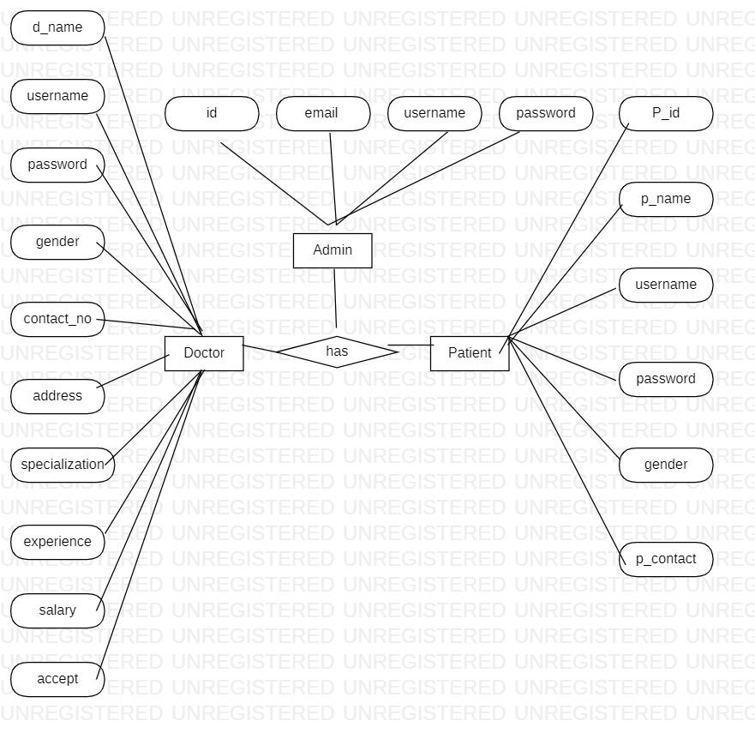
App flow

Slide 18

Snaps Homepage:

Slide 19
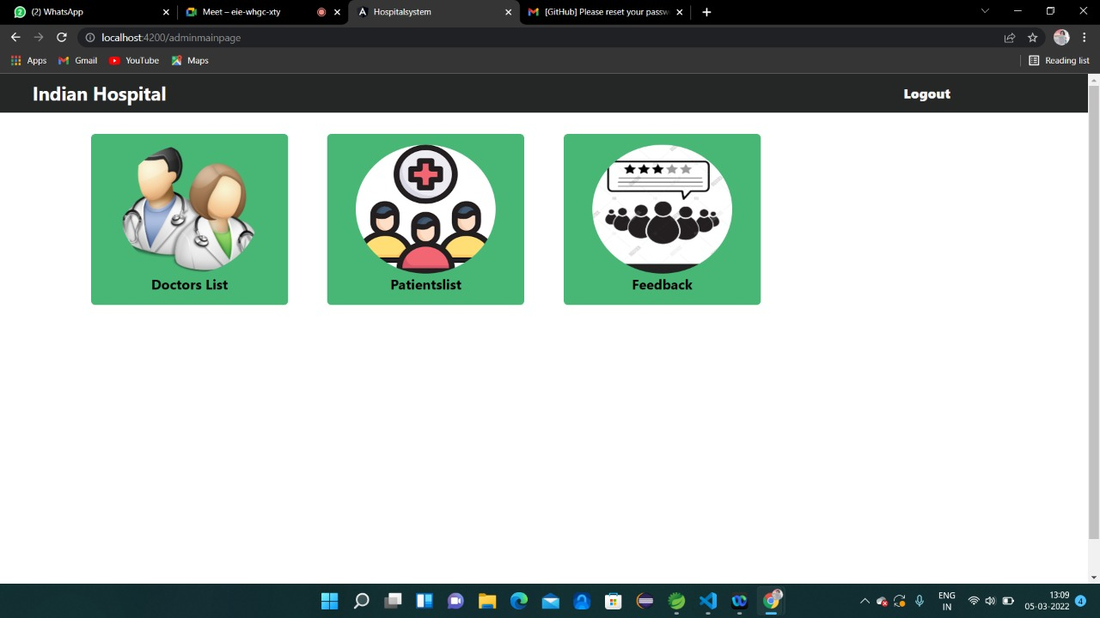
Admin page:

Slide 20
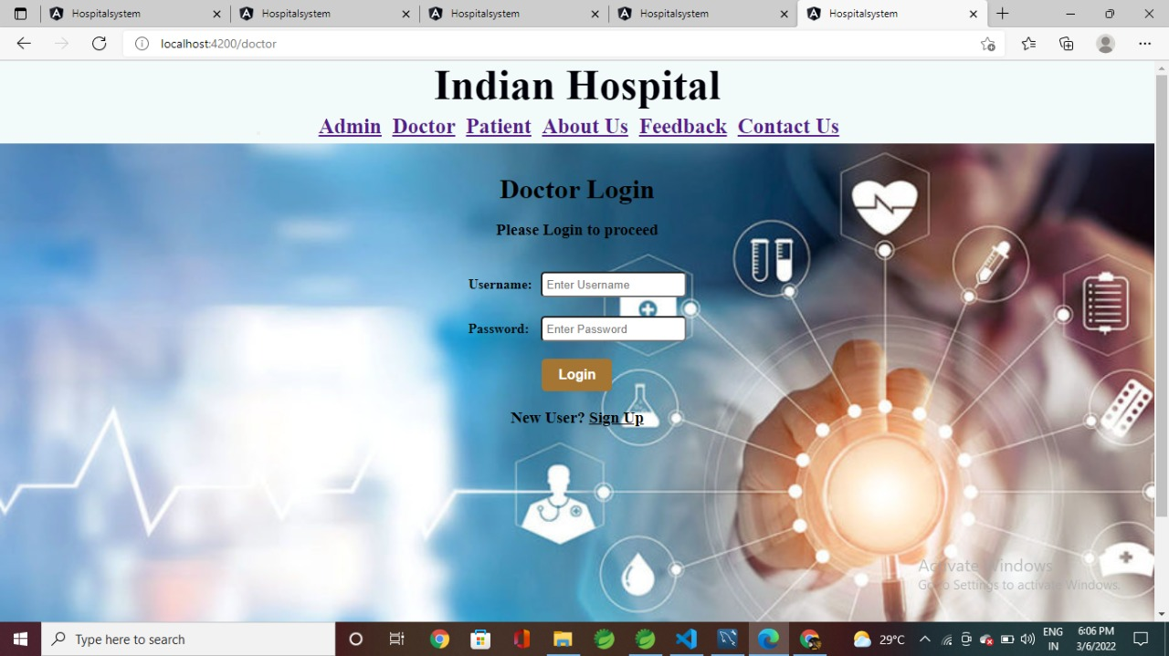
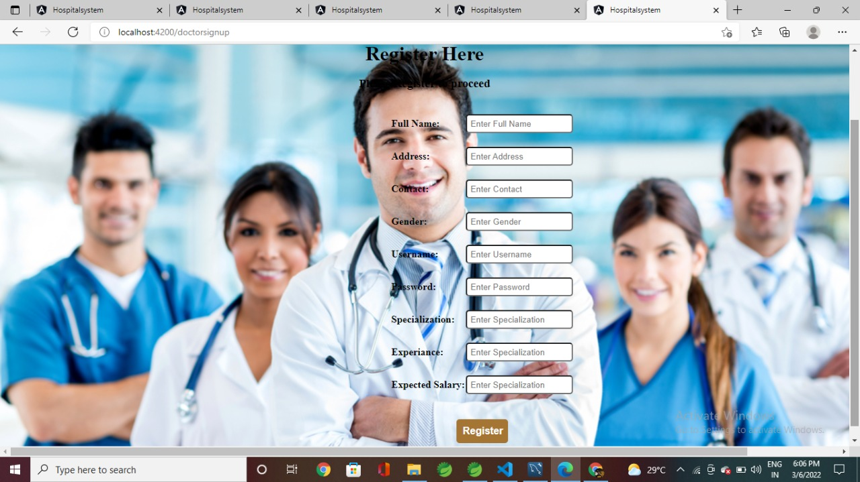
Doctor

Slide 21
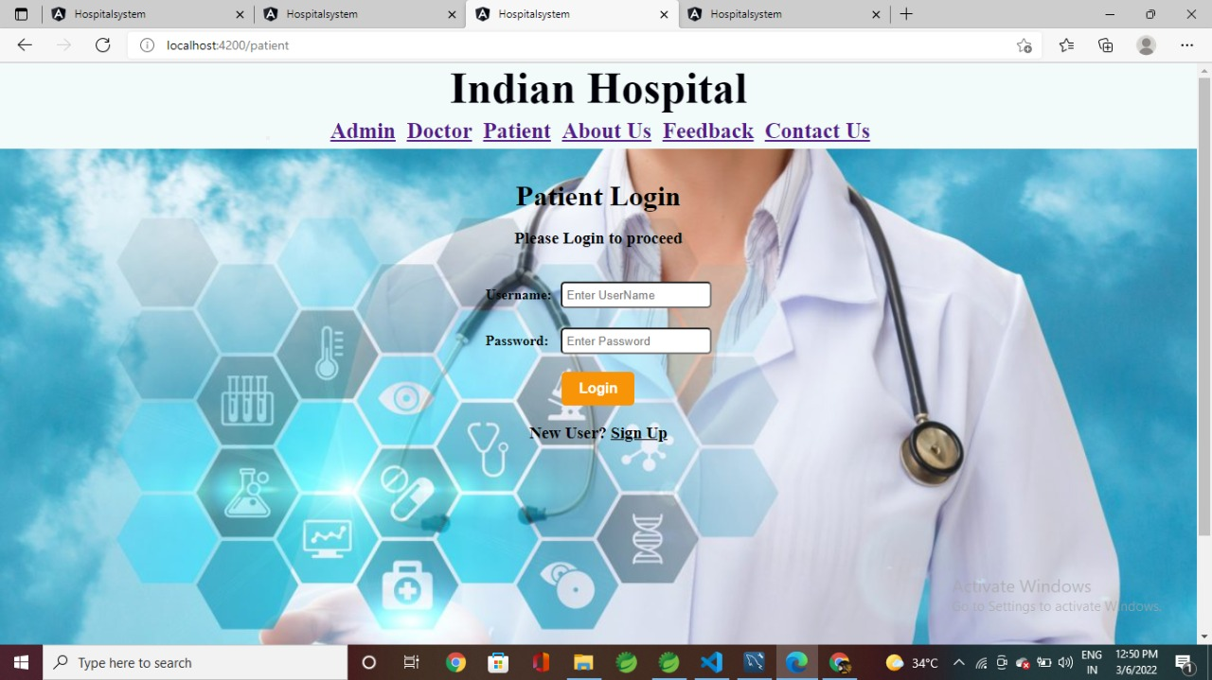
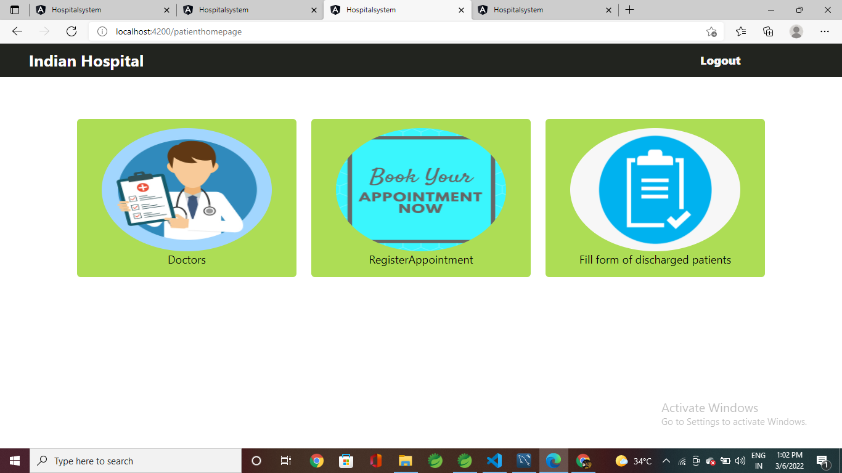
patient

Slide 22
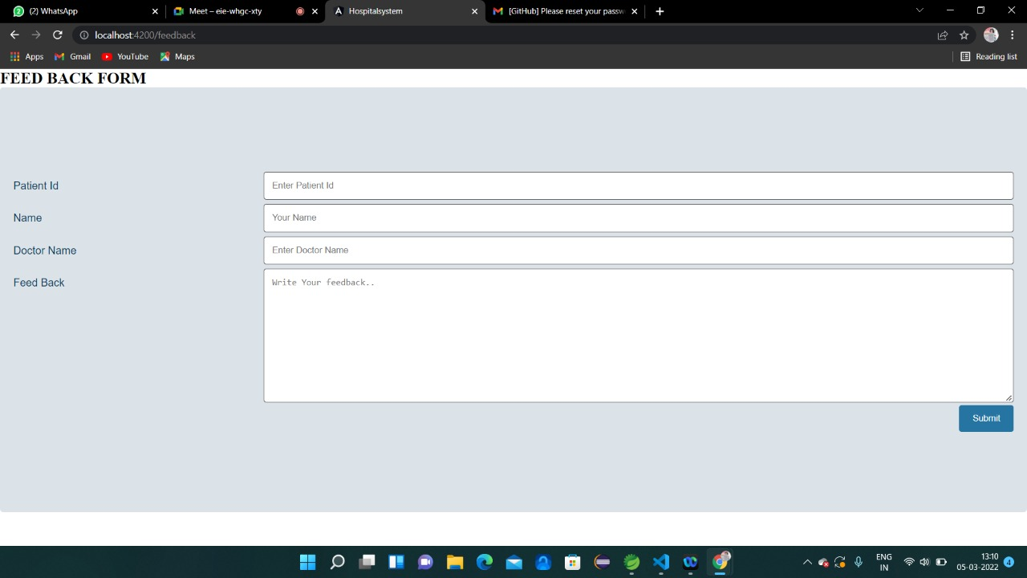
Feedback:

Slide 23
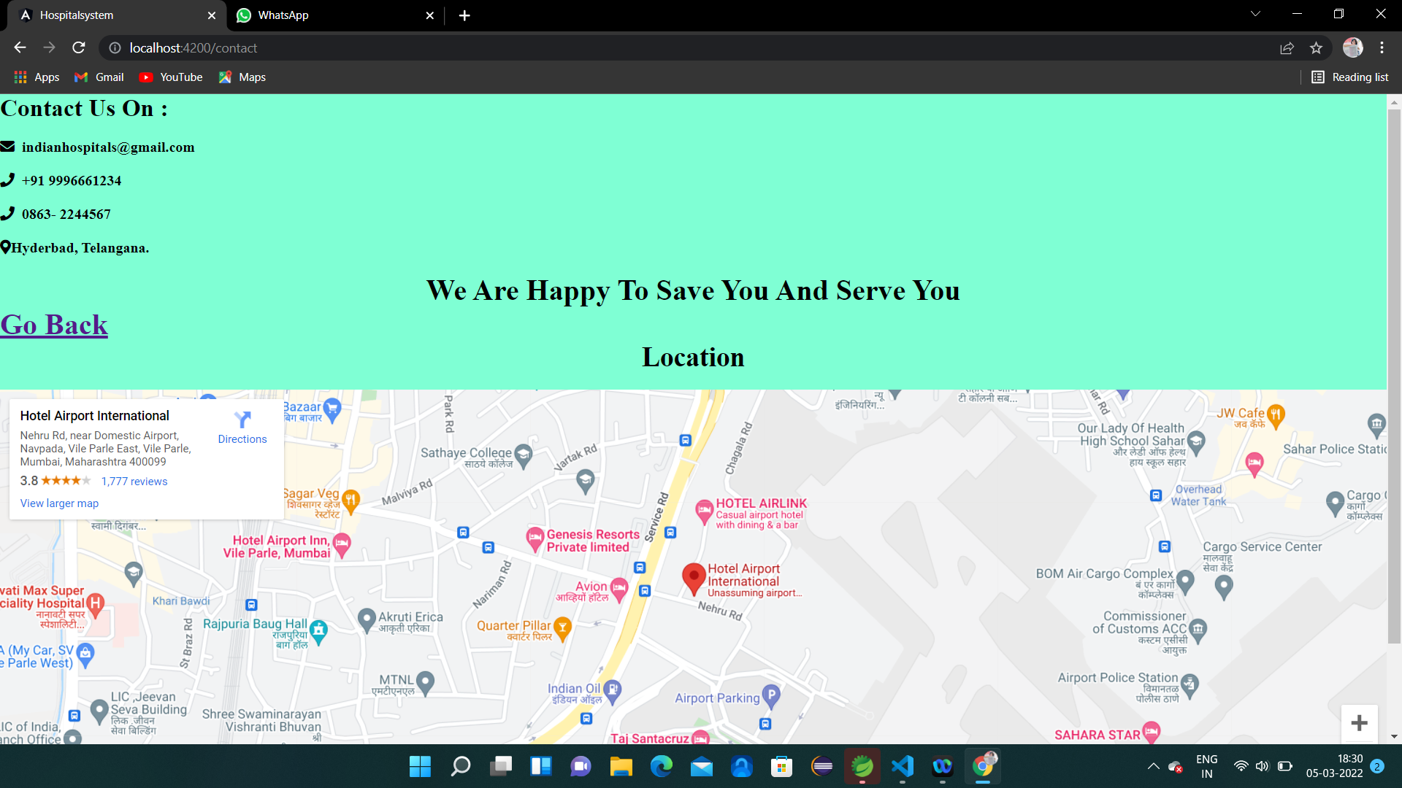
Contact us:

Slide 24
Future scope & Improvements
The proposed system is Hospital Management System, the system include more facilities like pharmacy system for the stock details of medicines in the pharmacy.
They providing such features enable the users to include more comments into the system.

Slide 25
Conclusion
Hospital management systems allows us the ability to optimize and digitize all the processes within the institution.
It will help to improve customer service, reduce process costs, streamline the search of medical records, bills, patients, doctors, etc.
Hospital Management System will contributed enormously to better health and influenced the lives and well-being of billions of humans.

Slide 26
Bibliography
www.google.com
www.stackoverflow.com
www.w3school.com
www.angular.io
https://github.com/DanWahlin/Angular-JumpStart.com
https://www.partech.nl/nl/publicaties/2020/07/9-trending-best-practices-for-rest-api-development.com

Slide 27

Thank You

